Slide 1
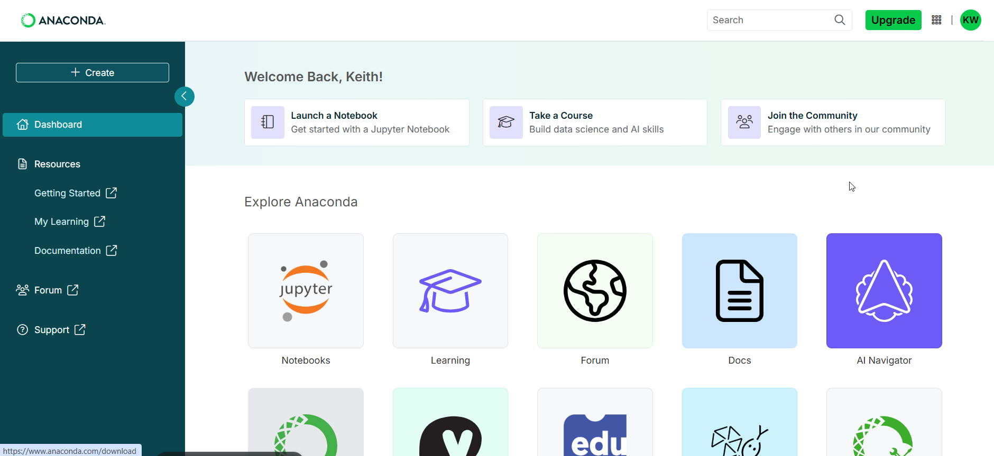
Anaconda App Dashboard
Set up an Anaconda account at https://anaconda.com
You will find Docs and courses under the Learning section.
Many courses require payment or a subscription but there are free courses
Once you have an account, a good starting place is
https://learning.anaconda.com/courses/jupyter-notebook-basics

Slide 2
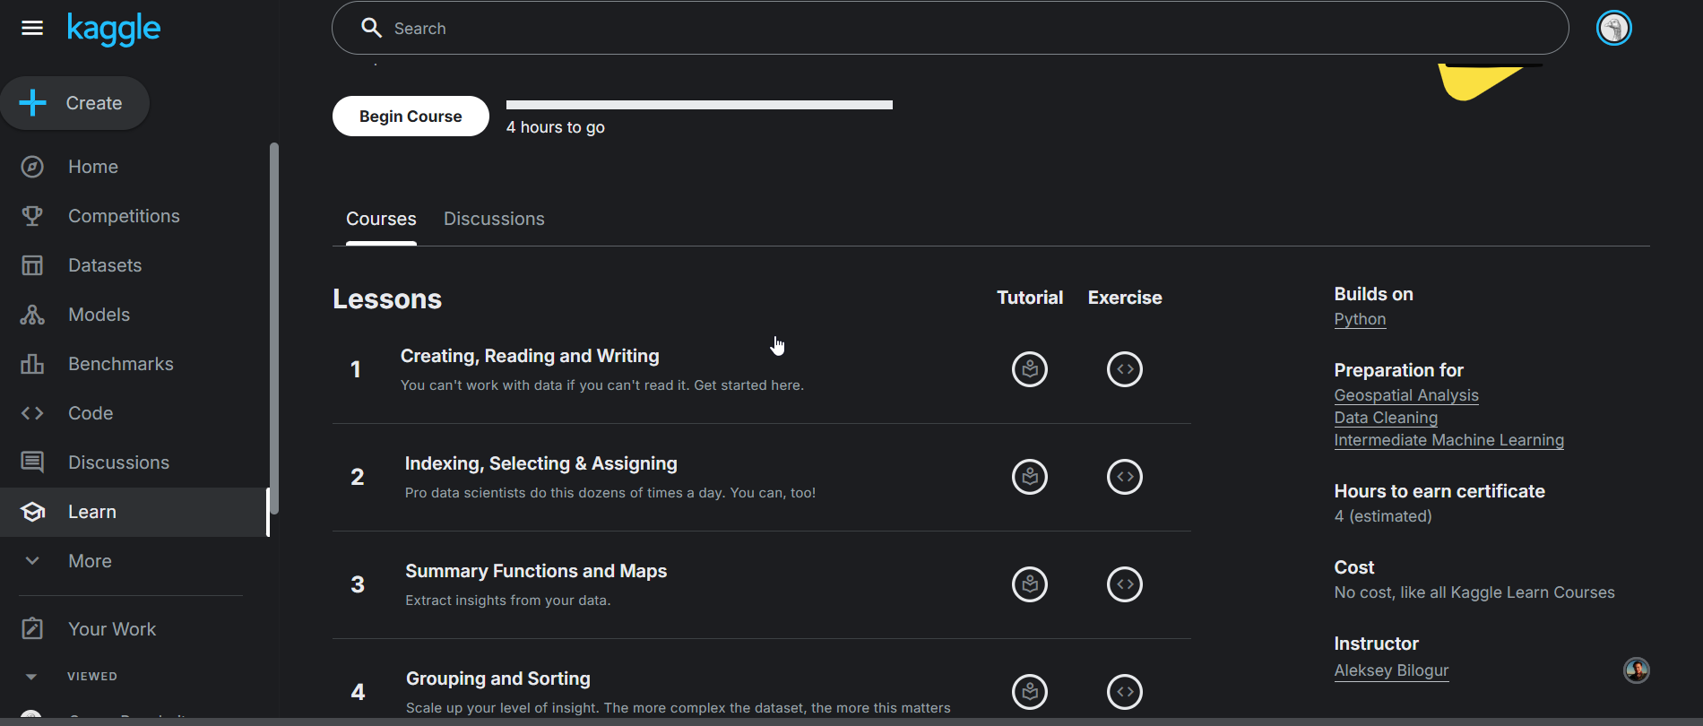
Learning Pandas on Kaggle
Set up a Kaggle account at https://www.kaggle.com/
Look on the left panel for the Learn link to access the courses on Kaggle
Take whatever courses capture your interest
The one of most immediate importance is the Pandas course https://www.kaggle.com/learn/pandas
Some others may prove useful soon
Intro to Machine Learning
Intermediate Machine Learning
Data Visualization
I find it’s best to start with a project or problem first, then look to courses for context

